Slide 1
Dijkstra’s Algorithm –
Single Source Shortest Path

Slide 2
Shortest Path Problems
What is shortest path ?
  shortest length between two vertices for an unweighted graph:
  smallest cost between two vertices for a weighted graph:
B
B
210
What is the Shortest path from E to D in both the graphs
A
A
450
60
30
C
unweighted graph
C
weighted graph
200
130
D
D
E
E

Slide 3
Shortest Path Problems
What is shortest path ?
  shortest length between two vertices for an unweighted graph:
  smallest cost between two vertices for a weighted graph:
B
B
210
A
A
450
60
30
C
unweighted graph
C
weighted graph
200
130
D
D
E
E

Slide 4
Shortest Path Problems
How can we find the shortest route between two points on a map?
Model the problem as a graph problem:
  Road map is a weighted graph:
  vertices = cities
  edges = road segments between cities
  edge weights = road distances
  Goal: find a shortest path between two vertices (cities)

Slide 5
Shortest Path Problems
Input:
  Directed graph G = (V, E)
  Weight function w : E → R
Weight of path p = ⟨v₀, v₁, . . . , v_{k}⟩
Shortest-path weight from u to v:
δ(u, v) = min w(p) : u v if there exists a path from u to v
∞ otherwise
Shortest path u to v is any path p such that w(p) = δ(u, v)
t
x
3
6
9
3
4
s
0
2
1
2
7
5
3
5
11
6
y
z
p

Slide 6
Variants of Shortest Paths
Single-source shortest path
  G = (V, E) ⇒ find a shortest path from a given source vertex s to each vertex v ∈ V
Single-destination shortest path
  Find a shortest path to a given destination vertex t from each vertex v
  Reverse the direction of each edge ⇒ single-source
Single-pair shortest path
  Find a shortest path from u to v for given vertices u and v
  Solve the single-source problem
All-pairs shortest-paths
  Find a shortest path from u to v for every pair of vertices u and v

Slide 7
Optimal Substructure of Shortest Paths
Given:
  A weighted, directed graph G = (V, E)
  A weight function w: E → R,
  A shortest path p = ⟨v₁, v₂, . . . , v_{k}⟩ from v₁ to v_{k}
  A subpath of p: p_{ij} = ⟨v_{i}, v_{i+1}, . . . , v_{j}⟩, with 1 ≤ i ≤ j ≤ k
Then: p_{ij} is a shortest path from v_{i} to v_{j}
Proof: p = v₁ v_{i} v_{j} v_{k}
w(p) = w(p_{1i}) + w(p_{ij}) + w(p_{jk})
Assume ∃ p_{ij}’ from v_{i} to v_{j} with w(p_{ij}’) < w(p_{ij})
⇒ w(p’) = w(p_{1i}) + w(p_{ij}’) + w(p_{jk}) < w(p)
v_{j}
p_{ij}
p_{jk}
v₁
p_{1i}
p_{ij}’
v_{k}
v_{i}
p_{1i}
p_{ij}
p_{jk}

Slide 8
Shortest-Path Representation
For each vertex v ∈ V:
d[v] = δ(s, v): a shortest-path estimate
  Initially, d[v]=∞
  Reduces as algorithms progress
π[v] = predecessor of v on a shortest path from s
  If no predecessor, π[v] = NIL
  π induces a tree—shortest-path tree
Shortest paths & shortest path trees are not unique
t
x
3
6
9
3
4
s
0
2
1
2
7
5
3
5
11
6
y
z

Slide 9
Initialization
Alg.: INITIALIZE-SINGLE-SOURCE(V, s)
for each v ∈ V
do d[v] ← ∞
π[v] ← NIL
d[s] ← 0
All the shortest-paths algorithms start with INITIALIZE-SINGLE-SOURCE

Slide 10
Relaxation
Relaxing an edge (u, v) = testing whether we can improve the shortest path to v found so far by going through u
  If d[v] > d[u] + w(u, v)
  we can improve the shortest path to v
  ⇒ update d[v] and π[v]
s
s
u
v
u
v
After relaxation:
  d[v] ≤ d[u] + w(u, v)
5
2
9
5
2
6
RELAX(u, v, w)
RELAX(u, v, w)
u
v
u
v
5
2
7
5
2
6

Slide 11
RELAX(u, v, w)
if d[v] > d[u] + w(u, v)
then d[v] ← d[u] + w(u, v)
π[v] ← u
All the single-source shortest-paths algorithms
  start by calling INIT-SINGLE-SOURCE
  then relax edges
The algorithms differ in the order and how many times they relax each edge

Slide 12
Dijkstra’s Algorithm
Single-source shortest path problem:
  No negative-weight edges: w(u, v) > 0 ∀ (u, v) ∈ E
Maintains two sets of vertices:
  S = vertices whose final shortest-path weights have already been determined
  Q = vertices in V – S: min-priority queue
    Keys in Q are estimates of shortest-path weights (d[v])
Repeatedly select a vertex u ∈ V – S, with the minimum shortest-path estimate d[v]

Slide 13
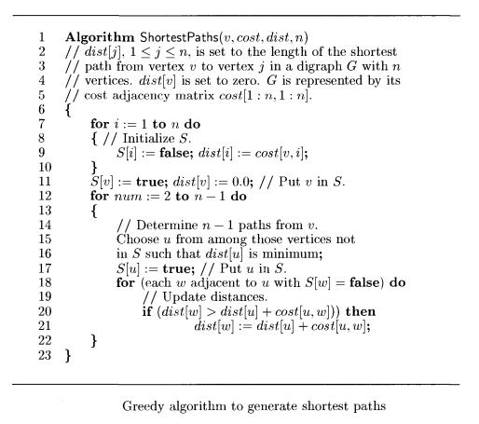
Dijkstra’s Algorithm

Slide 14
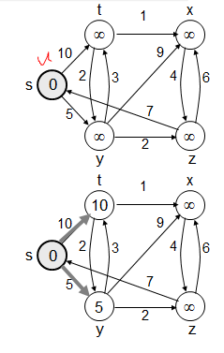
Example

Slide 15
Example
t
1
x
t
1
x
10
∞
8
14
8
14
13
10
9
10
9
s
0
2
3
4
6
s
0
2
3
4
6
5
7
5
7
5
∞
5
7
7
2
2
y
z
y
z
t
x
t
1
x
1
8
9
8
13
9
10
9
10
9
2
3
4
6
s
0
2
3
4
6
s
0
5
7
5
7
5
7
5
7
2
2
y
z
y
z

Slide 16
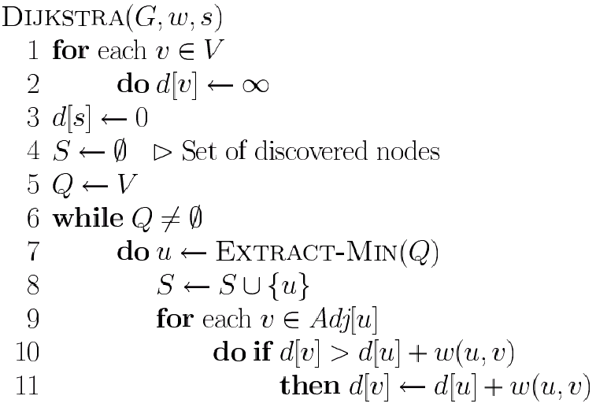
Dijkstra’s Pseudo Code
Graph G, weight function w, root s
relaxing edges

Slide 17
Dijkstra's Shortest Path Algorithm
Find shortest path from s to t.
2
24
3
9
s
18
14
6
6
2
30
4
19
11
15
5
5
6
20
16
7
t
44

Slide 18
Dijkstra's Shortest Path Algorithm
S = { }
Q = { s, 2, 3, 4, 5, 6, 7, t }
d | s | 2 | 3 | 4 | 5 | 6 | 7 | t
 | 0 | ∞ | ∞ | ∞ | ∞ | ∞ | ∞ | ∞
∞
∞
2
24
3
0
9
s
∞
18
14
6
6
2
∞
30
∞
4
19
11
15
5
5
6
20
16
7
t
44
distance label
∞
∞

Slide 19
Dijkstra's Shortest Path Algorithm
S = { }
Q = { s, 2, 3, 4, 5, 6, 7, t }
d | s | 2 | 3 | 4 | 5 | 6 | 7 | t
 | 0 | ∞ | ∞ | ∞ | ∞ | ∞ | ∞ | ∞
delmin
∞
∞
2
24
3
0
9
s
∞
18
14
6
6
2
∞
30
∞
4
19
11
15
5
5
6
20
16
7
t
44
distance label
∞
∞

Slide 20
Dijkstra's Shortest Path Algorithm
S = { s }
Q = { 2, 3, 4, 5, 6, 7, t }
d | s | 2 | 3 | 4 | 5 | 6 | 7 | t
 | 0 | 9 | ∞ | ∞ | ∞ | 14 | 15 | ∞
decrease key
∞
∞
9
X
2
24
3
0
9
s
∞
14
18
14
X
6
6
2
∞
30
∞
4
19
11
15
5
5
6
20
16
7
t
44
distance label
∞
15
∞
X

Slide 21
Dijkstra's Shortest Path Algorithm
S = { s }
Q = { 2, 3, 4, 5, 6, 7, t }
d | s | 2 | 3 | 4 | 5 | 6 | 7 | t
 | 0 | 9 | ∞ | ∞ | ∞ | 14 | 15 | ∞
delmin
∞
∞
9
X
2
24
3
0
9
s
∞
14
18
14
X
6
6
2
∞
30
∞
4
19
11
15
5
5
6
20
16
7
t
44
distance label
∞
15
∞
X

Slide 22
Dijkstra's Shortest Path Algorithm
S = { s, 2 }
Q = { 3, 4, 5, 6, 7, t }
d | s | 2 | 3 | 4 | 5 | 6 | 7 | t
 | 0 | 9 | ∞ | ∞ | ∞ | 14 | 15 | ∞
∞
∞
9
X
2
24
3
0
9
s
∞
14
18
14
X
6
6
2
∞
30
∞
4
19
11
15
5
5
6
20
16
7
t
44
∞
15
∞
X

Slide 23
Dijkstra's Shortest Path Algorithm
S = { s, 2 }
Q = { 3, 4, 5, 6, 7, t }
d | s | 2 | 3 | 4 | 5 | 6 | 7 | t
 | 0 | 9 | 33 | ∞ | ∞ | 14 | 15 | ∞
decrease key
∞
33
∞
X
9
X
2
24
3
0
9
s
∞
14
18
14
X
6
6
2
∞
30
∞
4
19
11
15
5
5
6
20
16
7
t
44
∞
15
∞
X

Slide 24
Dijkstra's Shortest Path Algorithm
S = { s, 2 }
Q = { 3, 4, 5, 6, 7, t }
d | s | 2 | 3 | 4 | 5 | 6 | 7 | t
 | 0 | 9 | 33 | ∞ | ∞ | 14 | 15 | ∞
∞
33
∞
X
9
X
2
24
3
0
9
delmin
s
∞
14
18
14
X
6
6
2
∞
30
∞
4
19
11
15
5
5
6
20
16
7
t
44
∞
15
∞
X

Slide 25
Dijkstra's Shortest Path Algorithm
S = { s, 2, 6 }
Q = { 3, 4, 5, 7, t }
d | s | 2 | 3 | 4 | 5 | 6 | 7 | t
 | 0 | 9 | 32 | ∞ | 44 | 14 | 15 | ∞
32
∞
33
∞
X
X
9
X
2
24
3
0
9
s
∞
14
18
14
X
6
6
2
44
∞
∞
4
30
X
19
11
15
5
5
6
20
16
7
t
44
∞
15
∞
X

Slide 26
Dijkstra's Shortest Path Algorithm
S = { s, 2, 6, 7 }
Q = { 3, 4, 5, t }
d | s | 2 | 3 | 4 | 5 | 6 | 7 | t
 | 0 | 9 | 32 | ∞ | 44 | 14 | 15 | ∞
32
∞
33
∞
X
X
9
X
2
24
3
0
9
s
∞
14
18
14
X
6
6
2
44
∞
∞
4
30
X
19
11
15
5
5
6
20
16
7
t
44
∞
15
delmin
∞
X

Slide 27
Dijkstra's Shortest Path Algorithm
S = { s, 2, 6, 7 }
Q = { 3, 4, 5, t }
d | s | 2 | 3 | 4 | 5 | 6 | 7 | t
 | 0 | 9 | 32 | ∞ | 35 | 14 | 15 | 59
32
∞
33
∞
X
X
9
X
2
24
3
0
9
s
∞
14
18
14
X
6
6
2
44
35
∞
X
∞
4
30
X
19
11
15
5
5
6
20
16
7
t
44
59
∞
∞
15
X
X

Slide 28
Dijkstra's Shortest Path Algorithm
S = { s, 2, 6, 7 }
Q = { 3, 4, 5, t }
d | s | 2 | 3 | 4 | 5 | 6 | 7 | t
 | 0 | 9 | 32 | ∞ | 35 | 14 | 15 | 59
delmin
32
∞
33
∞
X
X
9
X
2
24
3
0
9
s
∞
14
18
14
X
6
6
2
44
35
∞
X
∞
4
30
X
19
11
15
5
5
6
20
16
7
t
44
59
∞
∞
15
X
X

Slide 29
Dijkstra's Shortest Path Algorithm
S = { s, 2, 3, 6, 7 }
Q = { 4, 5, t }
d | s | 2 | 3 | 4 | 5 | 6 | 7 | t
 | 0 | 9 | 32 | ∞ | 34 | 14 | 15 | 51
32
∞
33
∞
X
X
9
X
2
24
3
0
9
s
∞
14
18
14
X
6
6
2
44
35
34
∞
X
X
∞
4
30
X
19
11
15
5
5
6
20
16
7
t
44
51
59
∞
∞
15
X
X
X

Slide 30
Dijkstra's Shortest Path Algorithm
S = { s, 2, 3, 6, 7 }
Q = { 4, 5, t }
d | s | 2 | 3 | 4 | 5 | 6 | 7 | t
 | 0 | 9 | 32 | ∞ | 34 | 14 | 15 | 51
32
∞
33
∞
X
X
9
X
2
24
3
0
9
s
∞
14
18
14
X
6
6
2
44
35
34
∞
X
X
∞
4
30
X
19
11
15
5
5
6
20
delmin
16
7
t
44
51
59
∞
∞
15
X
X
X

Slide 31
Dijkstra's Shortest Path Algorithm
S = { s, 2, 3, 5, 6, 7 }
Q = { 4, t }
d | s | 2 | 3 | 4 | 5 | 6 | 7 | t
 | 0 | 9 | 32 | 45 | 34 | 14 | 15 | 50
32
∞
33
∞
X
X
9
X
2
24
3
0
9
s
∞
14
18
14
X
6
6
2
35
34
45
∞
44
X
X
X
∞
4
30
X
19
11
15
5
5
6
20
16
7
t
44
50
51
59
∞
∞
15
X
X
X
X

Slide 32
Dijkstra's Shortest Path Algorithm
S = { s, 2, 3, 5, 6, 7 }
Q = { 4, t }
d | s | 2 | 3 | 4 | 5 | 6 | 7 | t
 | 0 | 9 | 32 | 45 | 34 | 14 | 15 | 50
32
∞
33
∞
X
X
9
X
2
24
3
0
9
s
∞
14
18
14
X
6
6
2
35
34
45
∞
44
X
X
X
∞
4
30
X
19
11
15
5
delmin
5
6
20
16
7
t
44
50
51
59
∞
∞
15
X
X
X
X

Slide 33
Dijkstra's Shortest Path Algorithm
S = { s, 2, 3, 4, 5, 6, 7 }
Q = { t }
d | s | 2 | 3 | 4 | 5 | 6 | 7 | t
 | 0 | 9 | 32 | 45 | 34 | 14 | 15 | 50
32
∞
33
∞
X
X
9
X
2
24
3
0
9
s
∞
14
18
14
X
6
6
2
35
34
45
∞
44
X
X
X
∞
4
30
X
19
11
15
5
5
6
20
16
7
t
44
50
51
59
∞
∞
15
X
X
X
X

Slide 34
Dijkstra's Shortest Path Algorithm
S = { s, 2, 3, 4, 5, 6, 7 }
Q = { t }
d | s | 2 | 3 | 4 | 5 | 6 | 7 | t
 | 0 | 9 | 32 | 45 | 34 | 14 | 15 | 50
32
∞
33
∞
X
X
9
X
2
24
3
0
9
s
∞
14
18
14
X
6
6
2
35
34
45
∞
44
X
X
X
∞
4
30
X
19
11
15
5
5
6
20
16
7
t
44
delmin
50
51
59
∞
∞
15
X
X
X
X

Slide 35
Dijkstra's Shortest Path Algorithm
S = { s, 2, 3, 4, 5, 6, 7, t }
Q = { }
d | s | 2 | 3 | 4 | 5 | 6 | 7 | t
 | 0 | 9 | 32 | 45 | 34 | 14 | 15 | 50
32
∞
33
∞
X
X
9
X
2
24
3
0
9
s
∞
14
18
14
X
6
6
2
35
34
45
∞
44
X
X
X
∞
4
30
X
19
11
15
5
5
6
20
16
7
t
44
50
51
59
∞
∞
15
X
X
X
X

Slide 36
Dijkstra's Shortest Path Algorithm
S = { s, 2, 3, 4, 5, 6, 7, t }
Q = { }
32
∞
33
∞
X
X
9
X
2
24
3
0
9
s
∞
14
18
14
X
6
6
2
35
34
45
∞
44
X
X
X
∞
4
30
X
19
11
15
5
5
6
20
16
7
t
44
50
51
59
∞
∞
15
X
X
X
X

Slide 37
Time Complexity: Using List
The simplest implementation of the Dijkstra's algorithm stores vertices in an ordinary linked list or array
  Good for dense graphs (many edges)
|V| vertices and |E| edges
Initialization O(|V|)
While loop O(|V|)
  Find and remove min distance vertices O(|V|)
Potentially |E| updates
    Update costs O(1)
Total time O(|V²| + |E|) = O(|V²| )

Slide 38
Time Complexity: Priority Queue
For sparse graphs, (i.e. graphs with much less than |V²| edges) Dijkstra's implemented more efficiently by priority queue
Initialization O(|V|) using O(|V|) buildHeap
While loop O(|V|)
    Find and remove min distance vertices O(log |V|) using O(log |V|) deleteMin
Potentially |E| updates
    Update costs O(log |V|) using decreaseKey
Total time O(|V|log|V| + |E|log|V|) = O(|E|log|V|)
|V| = O(|E|) assuming a connected graph

Slide 39
Dijkstra (G, w, s)
INITIALIZE-SINGLE-SOURCE(V, s)
S ← ∅
Q ← V[G]
while Q ≠ ∅
do u ← EXTRACT-MIN(Q)
S ← S ∪ {u}
for each vertex v ∈ Adj[u]
do RELAX(u, v, w)
Running time: O(VlgV + ElgV) = O(ElgV)
Θ(V)
O(V) build min-heap
Executed O(V) times
O(lgV)
O(E) times; O(lgV)

Slide 40
Dijkstra’s Running Time
Extract-Min executed |V| time
Decrease-Key executed |E| time
Time = |V| T_{Extract-Min} + |E| T_{Decrease-Key}
T depends on different Q implementations
Q | T(Extract-Min) | T(Decrease-Key) | Total
array | Ο(V) | Ο(1) | Ο(V ²)
binary heap | Ο(lg V) | Ο(lg V) | Ο(E lg V)
Fibonacci heap | Ο(lg V) | Ο(1) (amort.) | Ο(V lgV + E)

Slide 41
An Example
2
4
4
S
2
2
1
1
2
3
1
6
4
2
3
3
5

Slide 42
An Example
2
6
2
4
4
0
2
2
1
1
2
3
6
6
4
2
3
3
5
3
4

Slide 43
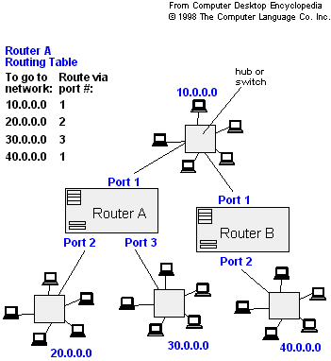
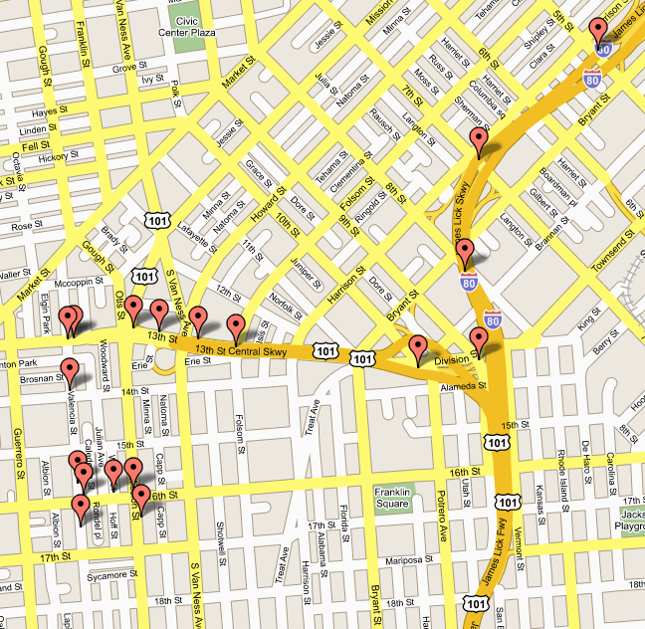
Applications of Dijkstra's Algorithm
- Traffic Information Systems are most prominent use
- Mapping (Map Quest, Google Maps)
- Routing Systems

Slide 44
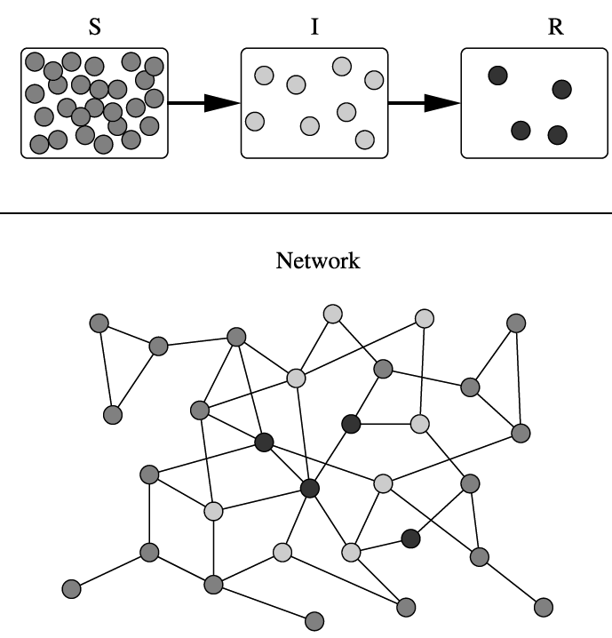
Applications of Dijkstra's Algorithm
One particularly relevant this week: epidemiology
Prof. Lauren Meyers (MIT, Biology Dept.) uses networks to model the spread of infectious diseases and design prevention and response strategies.
Vertices represent individuals, and edges their possible contacts. It is useful to calculate how a particular individual is connected to others.
Knowing the shortest path lengths to other individuals can be a relevant indicator of the potential of a particular individual to infect others.

Slide 45
Drawbacks of Dijkstra algorithm
The major disadvantage of the algorithm is the fact that it does a blind search there by consuming a lot of time waste of necessary resources.
Another disadvantage is that it cannot handle negative edges. This leads to acyclic graphs and most often cannot obtain the right shortest path.

Slide 46
References
http://staff.ustc.edu.cn/~csli/graduate/algorithms/book6/chap21.htm
https://www.youtube.com/watch?v=nZ0nFTvQez0
https://www.youtube.com/watch?v=E_AgyAI8lsc
https://brilliant.org/wiki/fibonacci-heap/
https://www.academia.edu/37584931/9_Dijkstra_pptx?auto=download

